Slide 1


SAP UI5 & FIORI with OData TRAINING
Anubhav Oberoy & Nishan Nainsukha
Day – 7

Slide 2

Agenda
Hook Methods in a Controller
Concept of Multiple Controller
Basic of Model in SAP UI5
Steps to Create a Model
Addressing Model Properties
Binding a JOSN Model with a Form Control
Binding Modes and Types of Binding
Binding Syntax
Aggregation Binding

Slide 3
Hook Methods in a Controller
SAPUI5 provides predefined lifecycle methods for controller. These are also called controller lifecycle hooks. These methods are
onInit()
onBeforeRendering()
It is a function which gets called immediately after UI5 creates the object of our controller. It is like constructure of a class. We can use this to initialize our class variable
It is a method which gets called MULTIPLE times, Before every time the view is displayed to the user. This is similar to PBO of a screen. We can use this method for pre-processing on a view.
IN
BR
EX
AR
onExit()
onAfterRendering()
It is a function which gets called before the instance of our controller gets destroyed. It is like destructor of a class.
We can use this to write clean-up code.
It is a method which gets called MULTIPLE times, After every time the view is displayed to the user. This method can be used to show effects to the user.

Slide 4

Exercise 1
In this exercise we will create a BaseController.
And we will get to know how our hook methods work.
Exercise Code:-
MyXML.view.xml
MyXML.controller.js

Slide 5
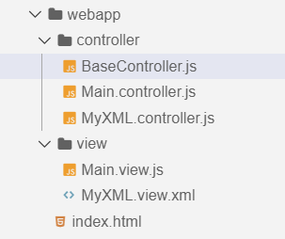
Concept of Multiple Controllers
Base Controller:- A base controller is a controller with basic functionalities from which the other controllers in your SAPUI5 application inherit.
The base controller holds basic functionalities that are used across multiple controllers.
The base controller itself is just another JavaScript file and it does not have the .controller prefix. Just BaseController.js and not BaseController.controller.js.
The base controller goes in the controller folder in your SAPUI5 application folder structure:
sap/ui/core/mvc/Controller
x
BaseController
Template
x
Controller 1
x
Controller 2
x
Controller 3
x
Controller 4
View 1
View 2
View 3
View 4

Slide 6

Exercise 2
In this exercise we will create a BaseController.
And we will get to know how our BaseController work.
Exercise Code:-
MyXML.view.xml
MyXML.controller.js
BaseController.js

Slide 7
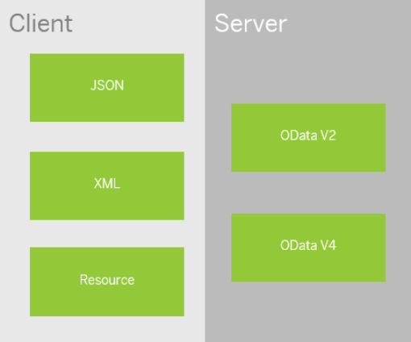
Basics of Models
All the models in SAP UI5 are characterized in two different parts:
Client Side Model: -
A model which keeps all the data in the browser. We use client side model for manipulating data (like internal table).
Server-Side Model: -
Keeps data on server side, and ON-demand, it is loaded by client using the server side model.
We can use the APIs (Methods) provided by SAP to access data from model
We need to get model object using methods
getModel(modelName)
setModel(modelName)
From model object we get access to the data using methods
setProperty(sPath, sValue)
getProperty(sPath)

Slide 8

Steps to Create a Model
3 Easy Steps to Create a Model
Step 1: Create a brand new object of the Model
To Create JSON Model - var oModel = sap.ui.model.json.JOSNModel()
To create XML model – var oModel = sap.ui.model.xml.XMLModel()
To create Resource model – var oModel = sap.ui.model.resource.ResourceModel()
To create OData Model – var oModel = sap.ui.model.odata.v2.ODataModel()
Step 2: Set or Load the data in the Model
oModel.setData({});
oModel.loadData(filePath);
Step 3: Make the model aware to the application/view
sap.ui.getCore().setModel(oModel);
this.getView().setModel(oModel);

Slide 9
How to Address Model Properties?
In the json data we can make address as “Every curly braces is converted to / and every array item is converted to /index”.
{
"empStr": {
"empId": 0001,
"empName": "Anubhav",
"salary": 8000,
"currency": "USD"
},
"empTab": [{
"empId": 0009,
"empName": “Ananya",
"salary": 9500,
"currency": "USD“
}, {
"empId": 0010,
"empName": “Shwetha",
"salary": 10000,
"currency": “EUR"
}]
}
What is the currency in which Ananya was paid?
/empTab/0/currency
What is currency in which Anubhav is paid?
/empStr/currency

Slide 10

Exercise 3
In this Exercise we will create a JSON Model in the controller and bind it to the form fields.
Exercise Code:-
MyXML.view.xml
MyXML.controller.js
Exercise 4
In this Exercise we will create a folder named model in the our webapp folder and create a demo data files and create a model.js file to initialize the model
Exercise Code:-
MyXML.view.xml
MyXML.controller.js
sample.json
data.json
Model.js

Slide 12
var oModel= sap.ui.getCore().getModel();
oModel.setProperty("/empStr/empName","Harish");
oModel.getProperty("/empStr/empName");

Slide 13
Binding Modes and Types of Binding
The binding mode defines how the data sources are bound.
A Binding mode decides how a UI5 model binding with its view will behave.
One Way – data change in model reflects on the UI
Two Way – data change in model reflects on UI also reflects on Model when changed on UI
One Time – the data between model and UI exchange only once at start of application.
Binding Types
SAPUI5 supports four different binding types: Property binding, aggregation binding, element binding and Expression Binding.
Property Binding Property binding allows properties of the control to get automatically initialized and updated from model data.
Expression Binding It is used for conditional binding, whenever we have a condition which influence our binding, we will use the expression binding. As a input we will pass an expression
Expression ➔ {= condition ? Truthy : False}
Model | Default binding mode
Resource model | One-time
JSON model | Two-way
XML model | Two-way
OData model | One-way

Slide 14
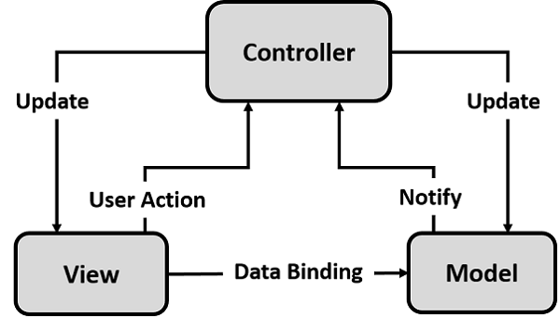
Binding Syntax
There 4 ways we can achieve the binding
Direct path inside curly braces → {path of json property}
Put a path property against the path → {path : ‘path of json property’}
We can use a dedicated bind method for the control → e.g. for input field we want to bind value hence we use bindValue method
A generic method called bindProperty(path, value)
Expression Binding
It is used for conditional binding, whenever we have a condition which influence our binding, we will use the expression binding. As a input we will pass an expression
Expression ➔ {= condition ? Truthy : False}

Slide 15

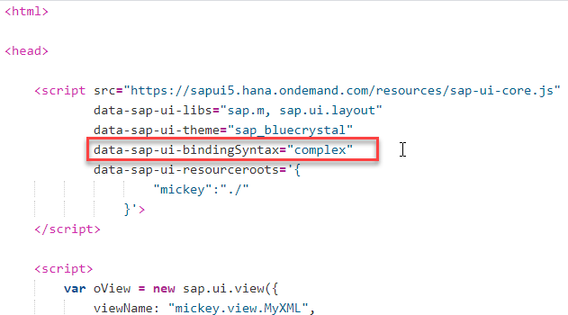
Exercise 5
Change the employee salary if the employee name is Anubhav
MyXML.view.xml
Index.html

Slide 16

Aggregation Binding
Aggregation Binding is a binding which is used for complex controls like table. Through the expression binding system will clone the UI Controls based on the data.
Absolute Path
A path is which passed at parent control level which usually points to an entityset of an json model. E.g. when we did binding for table rows=/empTab here /empTab was a absolute path.
Relative Path
A path which is passed at the child control level, it is always assumed that this path is relative to the parent which means the attribute exist in json w.r.t the parent entity. E.g. when we bind a column we pass the empId which is a relative path found inside the json with its absolute path /empTab

Slide 17

Exercise 6
Create a ui table
MyXML.view.xml
MyXML.controller.js

Slide 18

End of Day 7

Slide 19

Any Questions ?

Slide 20

Anubhav Oberoy

